Slide 1


INDUSTRIAL SAFETY AND RISK PERCEPTION
MADE EASY
SAFE
BOT

Slide 2

PROJECT
MENTOR
Raj
Mr. Rohit
GROUP
MEMBERS
Shankhadeep
Chaudhuri
Mario
Mathew
Kiran
K Bobba
John
Cherian
Ajay
Kumar

Slide 3
BOT to SORT for…
Conversational AI gaining a lot of momentum with many business verticals such as Retail, Supply chain, Healthcare and E-Commerce productionizing and what we are implementing is a subset of it called Safe Bot.
Automation enables efficient and cost-effective operations. It enhances the very core of the business and helps build intelligent new capabilities across the enterprise.
Objective
----------------------------------------------
Presumption of cause of accidents
Surveying a factor that increases severity of accidents
Building the model which classify the severity of accidents and understand the factor related to the causality of accidents.
Two models were built based on those cases below.
Accident level and Potential accident level
Steps taken
----------------------------------------------
SLACK is the chosen UI.
Flask is used as API to expose the model output.
RASA is chosen as the server for hosting NLP modules.
FastText is the model which attained the highest accuracy.
What has been achieved ?
----------------------------------------------
A vivid representation of collaboration and teamwork is seen in the project.
An average accuracy has been reached from a critical dataset.
A full working E2E industry ready solution can be seen.
Many opportunities were found which can be leveraged in the future.

Slide 4
PROBLEM STATEMENT
For industries around the world, accidents in the workplace are of a major concern, since it affects the lives and wellbeing of their employees, contractors and their families and the industry faces loses in terms Of hospital charges, litigation fees, reputation and lost employee morale. Based on these facts is intended to build a chatbot that can highlight the safety risk as per the incident description to the professionals including:
Personnel from the safety and complaince team
Senior management from the plant
Personnel from other plants across the globe
Government and industrial safety groups
Anyone interested or doing research in industrial safety
Emergency health and safety teams
Fire safety and industrial hazard teams
General management
Other personnel requiring safety risk information
so that these professionals Can:
Take preventive and proactive measures based on history, react faster to employee satisfaction related to safety, help position the equipment and machinery in a safe place where risk of potential accidents can be minimized, gain insights about safety in industries safety is paramount, reduce insurance cost by better handling of personnel, equipment and other resources, take other safety related decisions and actions.

Slide 5
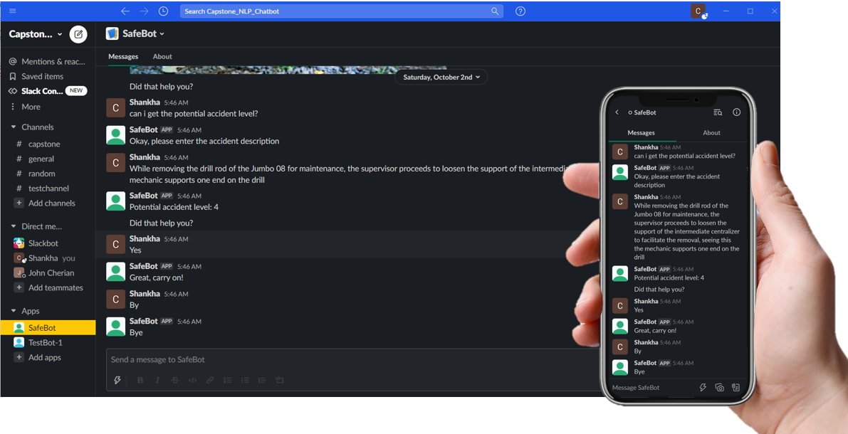
SAFEBOT at a Glace

Slide 6
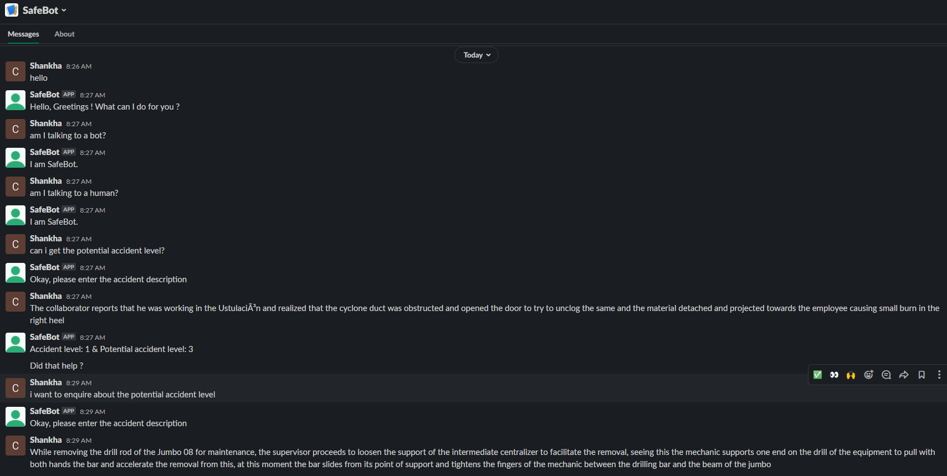
CONVERSATION

Slide 7
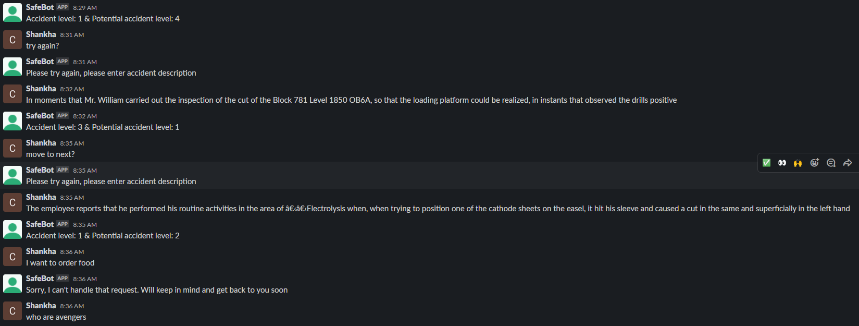
CONVERSATION

Slide 8
What is running in the background ?

Slide 9
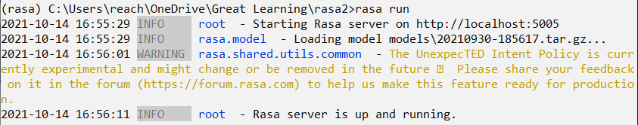
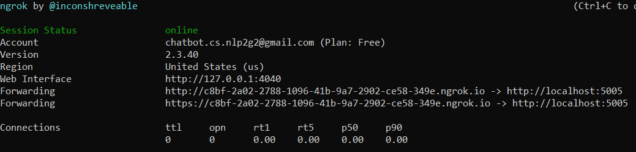
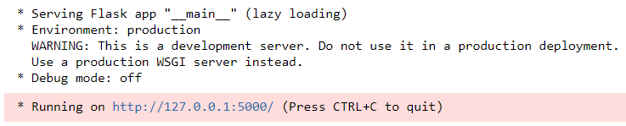
Back GROUND SERVICES .. At a glaNce
Rasa Server :
Client Server : NGROK
RASA Action Server :
Flash API :

Slide 10
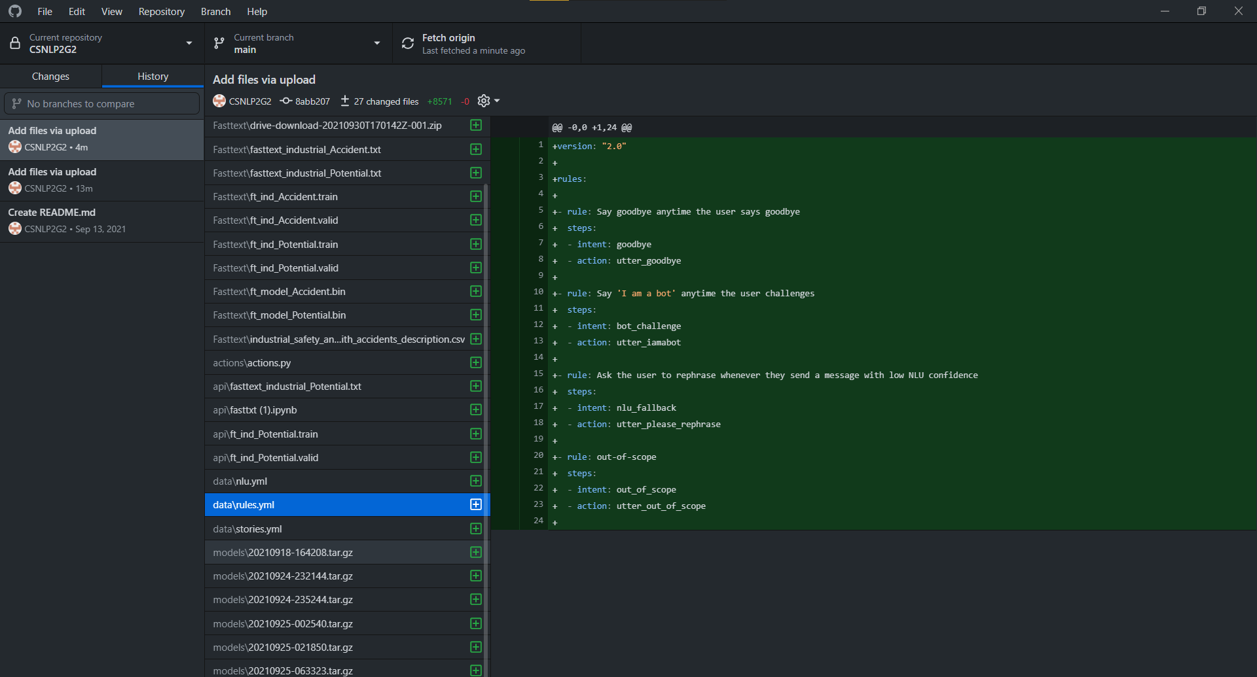
GitHub REPO

Slide 11
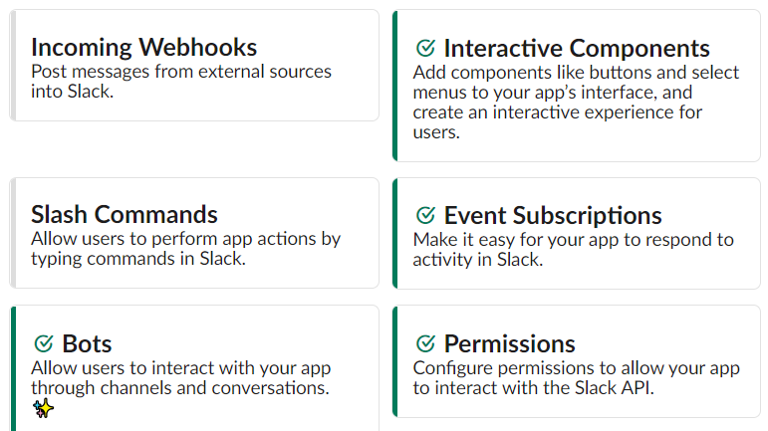
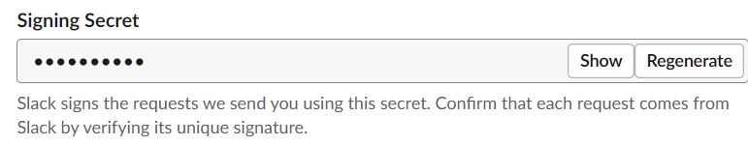
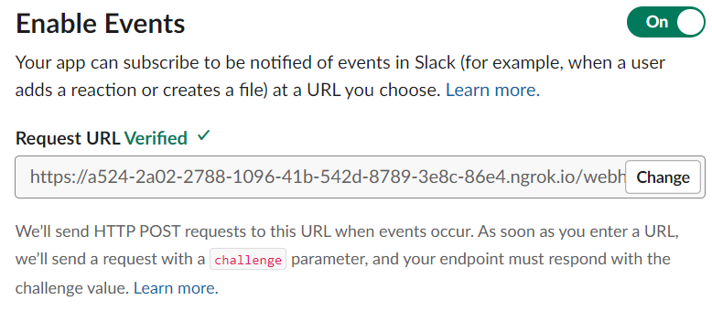
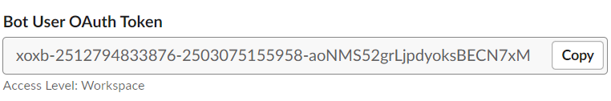
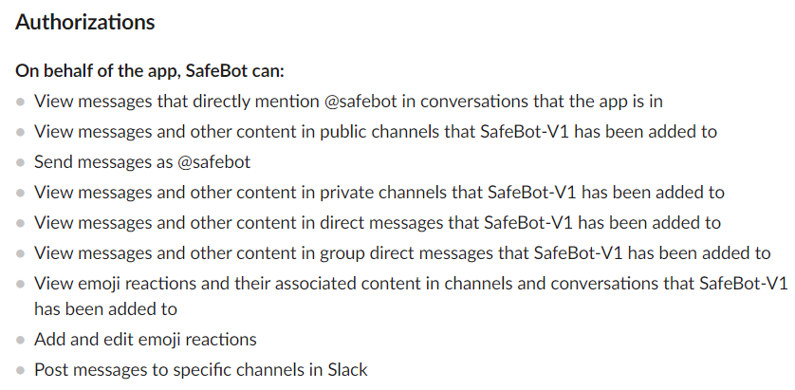
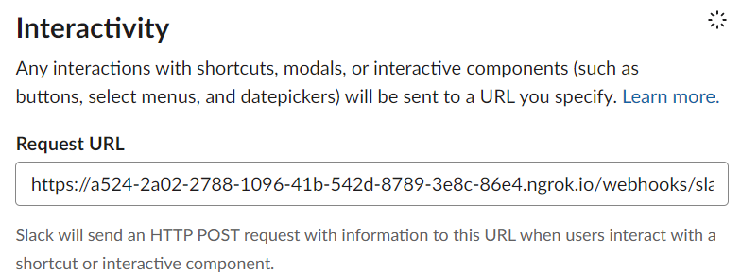
Slack connects at the glaNce
BOT Creation
Login Credentials
Outgoing event connect – via client server NGROK
(Exploring RASA server)
Incoming event connect – via client server NGROK
(Exploring RASA server)

Slide 12
The Architecture

Slide 13

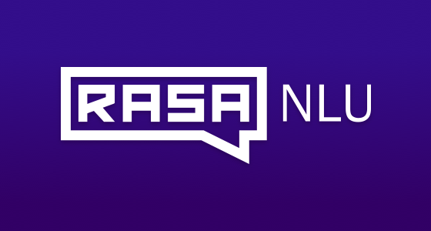



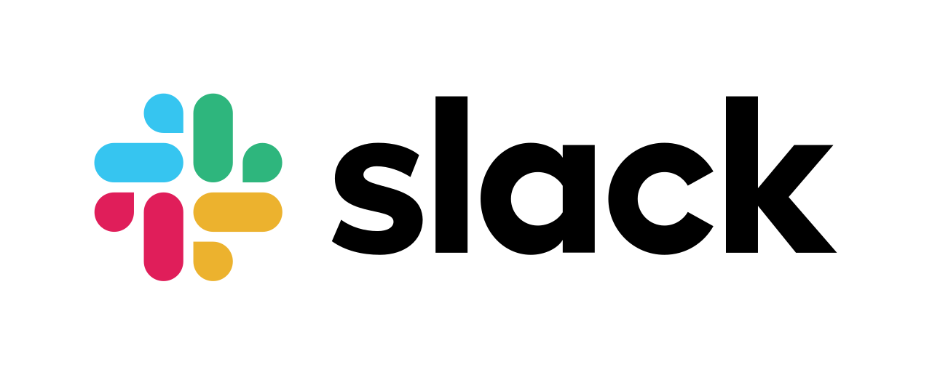

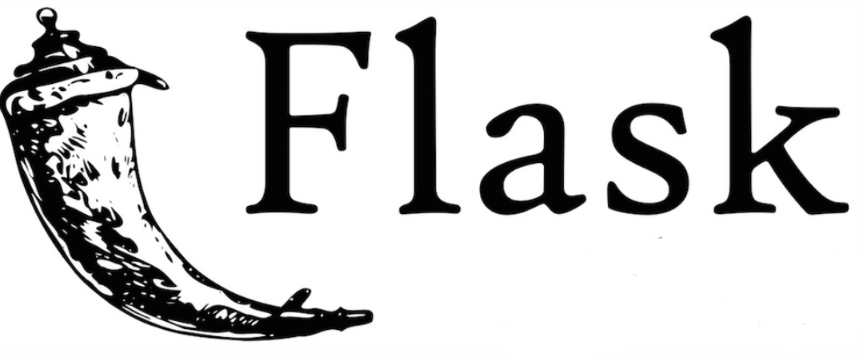

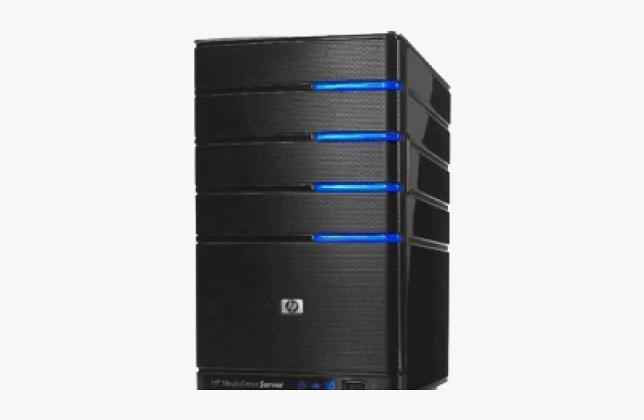

SAFEBOT - ARCHITECTURE
Training Space
SAFEBOT
DISTRIBUTION
Training Data
Desktop
NLU MODEL
Intents
BOT MODEL
Utter
Intents
Stories
BOT MODEL
MESSAGE
MESSAGE
DIALOGUE
MODEL
Domain
ANSWER
MESSAGE
External NLU
RASA SDK
SAFE BOT
Description ->
Action
Server
API
<- Predictions
DATA TRACKING
Mobile
Local Server

Slide 14
Story : How the end result has been reached ?
Step 1 : EDA

Slide 15
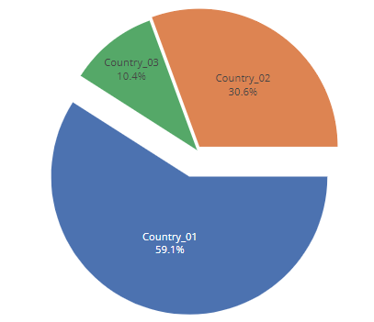
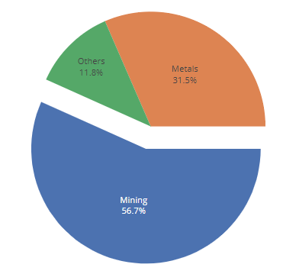
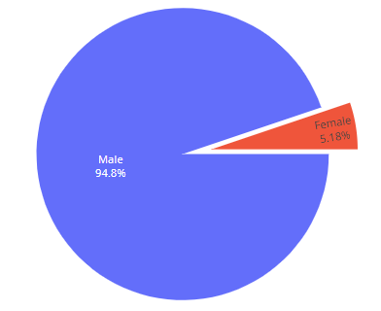
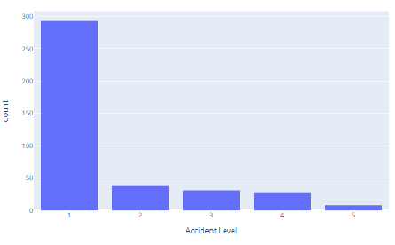
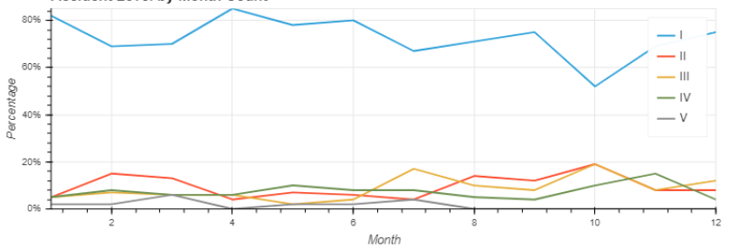
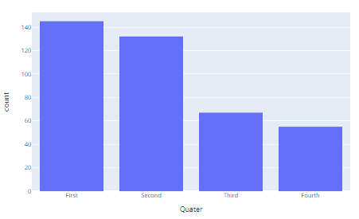
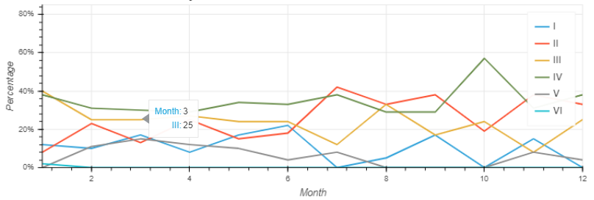
VISUAL ANALYSIS
Categorization has been done for accident severity which also follows the most obvious trends.
Most possible cases of accident has been witnessed first quater.

Slide 16
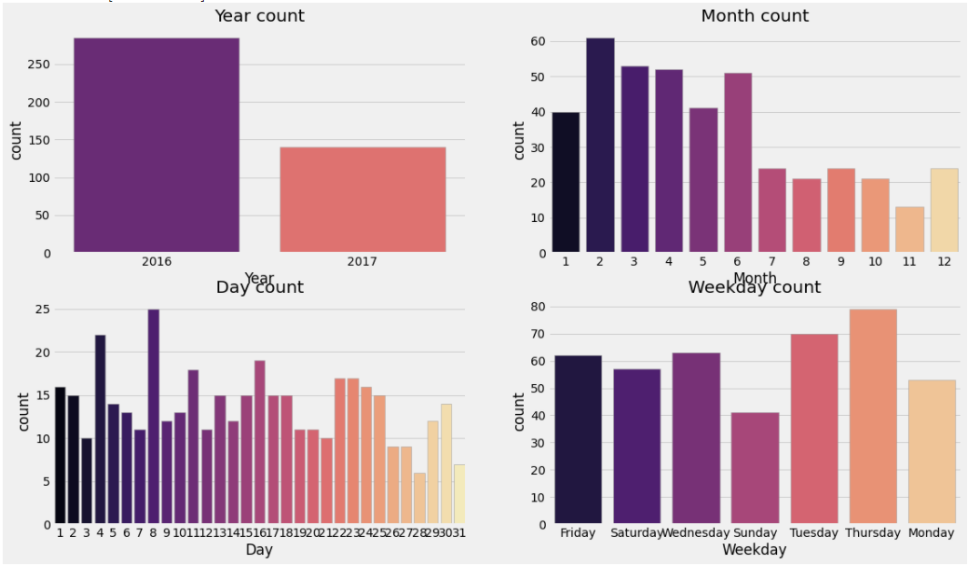
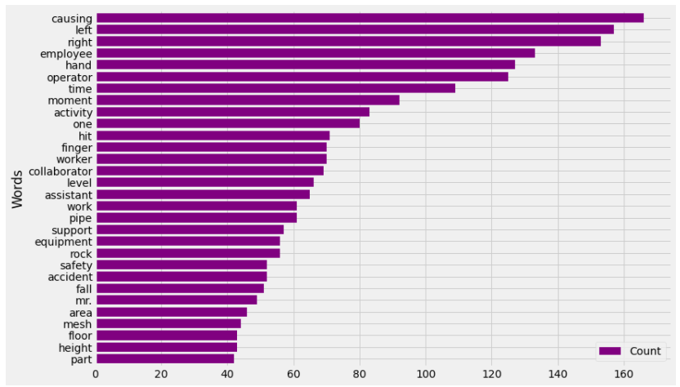
Continued…
It is observed that number of accidents occurred in 2016 is more compared to 2017, in year 2016 we have all 12 months of data whereas year 2017 has only 7 months of data.
It seems that the number of accidents decreased in latter of the year / month.
The most frequent word is causing (a verb).
There are several nouns like pipe, collaborator, time etc.
Most accidents involved the hands of the persons involved from which we can draw a statement that operation procedure well define can definitely impose accident-avoidance conditions.
There are other words which depict some sort of action (verbs). For example, hit, remove, fall move...etc.

Slide 17
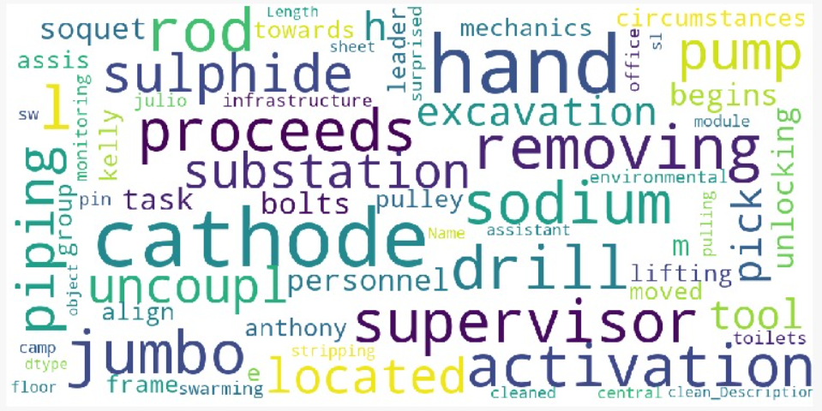
Continued…WORD CLOUD analysis
Observations
There are many body-related, employee related, movement-related, equipment-related and accident-related words.
Body-related: left.
Employee-related: employee, supervisor.
Movement-related: drill, lift, align, remove
Equipment-related: cathode, pump, rod, sodium.
Accident-related: accident, activity.

Slide 18
Step 2 : Model Building and Tuning

Slide 19

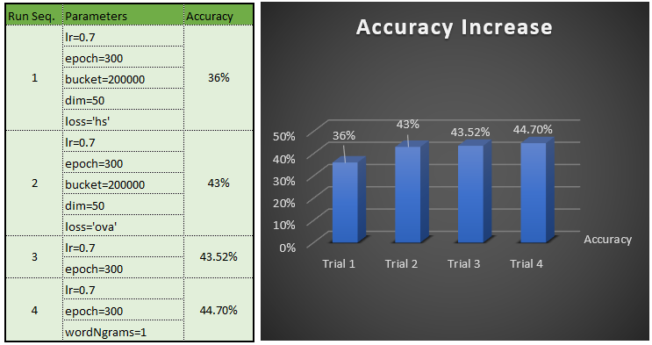
FAST TEXT
APPROACH
Hyper Parameter tunning with EPOCH , Learning rate, OVA Loss function and multilevel classifier help achieve 88% precision and Recall of 44.7 % .
Adding more than '1' Wordgram didn’t show any improvement in accuracy.
Note:
The accuracy is not consistent across multiple trials and tend to fluctuate between 40 to 50 %.
FastText is an open-source, free, lightweight library that allows users to learn text representations and text classifiers
It works on standard, generic hardware. Models can later be reduced in size to even fit on mobile devices.
Result Achieved

Slide 20
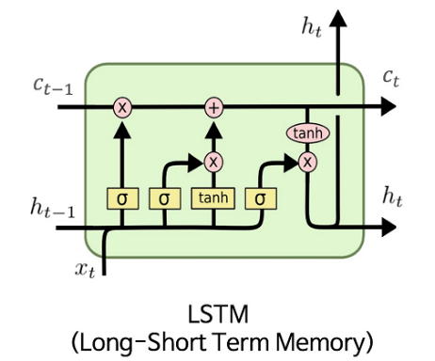
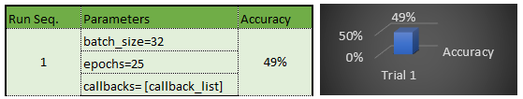
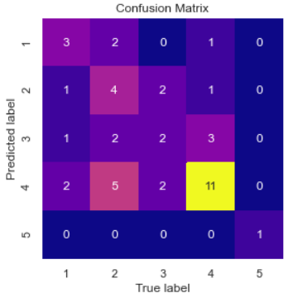
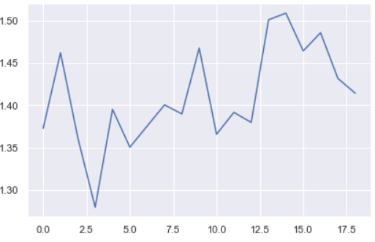
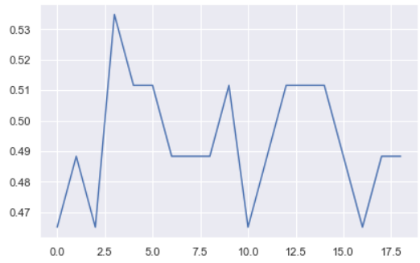
LSTM
APPROACH
A common LSTM unit is composed of a cell, an input gate, an output gate and a forget gate. The cell remembers values over arbitrary time intervals and the three gates regulate the flow of information into and out of the cell.
LSTM networks are well-suited to classifying, processing and making predictions based on time series data, since there can be lags of unknown duration between important events in a time series. LSTMs were developed to deal with the vanishing gradient problem that can be encountered when training traditional RNNs. Relative insensitivity to gap length is an advantage of LSTM over RNNs, hidden Markov models and other sequence learning methods in numerous applications.
An artificial recurrent neural network (RNN) architecture used in the field of deep learning.
It is well-suited to classifying, processing and making predictions based on time series data, since there can be lags of unknown duration between important events in a time series.
Result Achieved
Model Loss function
Model accuracy
Confusion Matrix

Slide 21
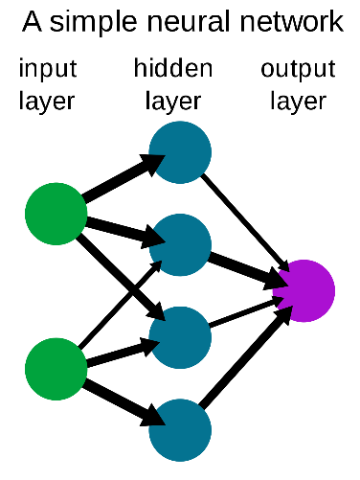
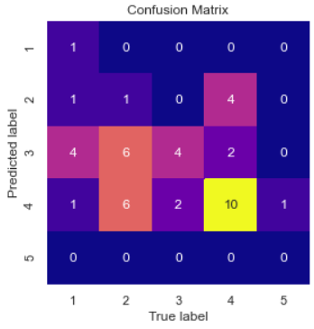
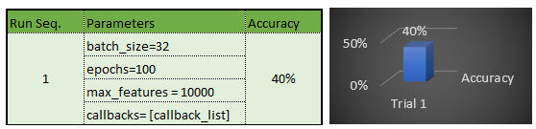
NUERAL NETWORK CLASSIFIER
APPROACH
The model is split into 382 group for train and 43 groups for test.
Max features used is 10000
Steps used :
Pad sequences
Creating weight matrix and Glove embeddings.
Glove used : glove.6B.200d
Layer structure used :
Dense(100, activation='relu',input_shape=())
Dropout(0.4))
BatchNormalization()
Dense(50, activation='relu')
Dropout(0.4)
BatchNormalization()
Dense(25, activation='relu')
Dropout(0.4)
Confusion Matrix
Result Achieved

Slide 22
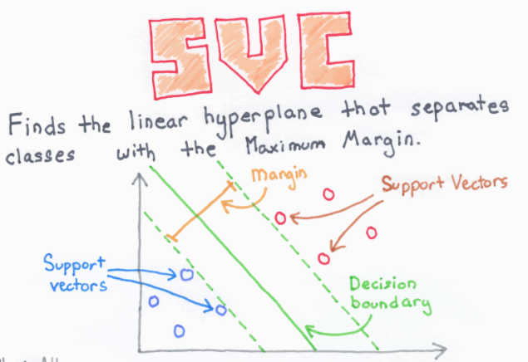
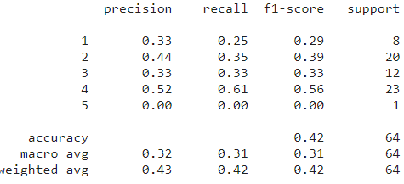
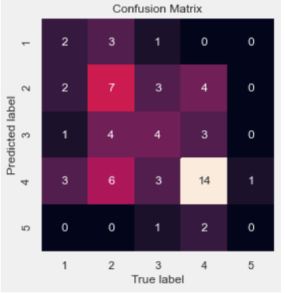
LINEAR SVC MODEL
APPROACH
The Linear Support Vector Classifier (SVC) method applies a linear kernel function to perform classification and it performs well with many samples. If we compare it with the SVC model, the Linear SVC has additional parameters such as penalty normalization which applies 'L1' or 'L2' and loss function.
Result Achieved
Confusion Matrix

Slide 23
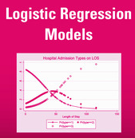
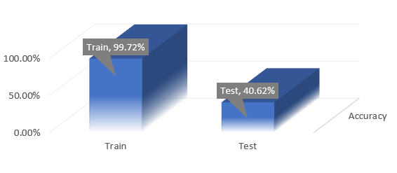
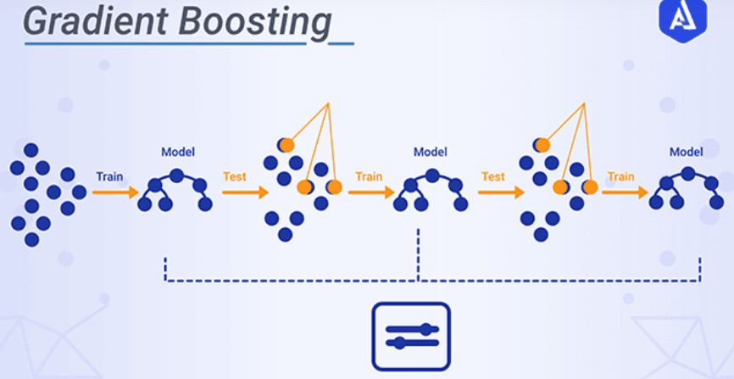
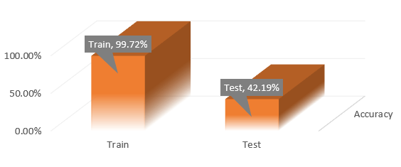

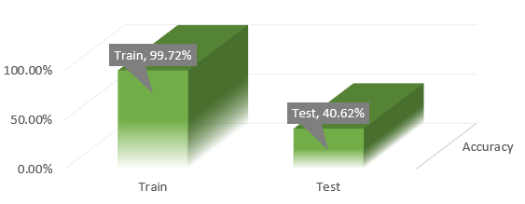
OTHER MODELS TRIED
Logistic regression is a statistical model that in its basic form uses a logistic function to model a binary dependent variable, although many more complex extensions exist. In regression analysis, logistic regression (or logit regression) is estimating the parameters of a logistic model (a form of binary regression.
Gradient boosting is a machine learning technique for regression, classification and other tasks, which produces a prediction model in the form of an ensemble of weak prediction models, typically decision trees.
Random forests or random decision forests are an ensemble learning method for classification, regression and other tasks that operates by constructing a multitude of decision trees at training time. For classification tasks, the output of the random forest is the class selected by most trees. For regression tasks, the mean or average prediction of the individual trees is returned.

Slide 24
FINAL Model comparison
Key Highlights:
The best performing model is FASTTEXT.
The poorest performer is Logistic regression.
A Bidirectional LSTM is a sequence processing model that consists of two LSTMs: one taking the input in a forward direction, and the other in a backwards direction. We have used Bidirectional LSTM with various hyperparameters such as 50 LSTM cells and Dropout to avoid overfitting. We have also used callback functions to stop the running if val_loss did not improve with patient level of 10. The Model is facing some overfitting issue due to less no. of observation and lots of Naming and unwanted words in the corpus. We are taking manual steps to clean the corpus as we have 425 observations.
✓ Logistic model is used to model the probability of a certain class or event existing such as pass/fail, win/lose and alive/dead. Model is also facing overfitting. We are trying more hyperparameter tuning to improve the test accuracy.
The Objective of a Linear SVC (Support Vector Classifier) is to fit to the data you provide, returning a "best fit" hyperplane that divides, or categorizes, your data. From there, after getting the hyperplane, you can then feed some features to your classifier to see what the "predicted" class is. As the model is facing overfitting issue. We are working on more hyperparameter tuning and Data cleaning part.
GBM is a sequential model. It relies on the intuition that the best possible next model, when combined with previous models, minimizes the overall prediction error. The key idea is to set the target outcomes for this next model to minimize the error. Model build is also facing overfitting. We are also trying more hyperparameter tuning to improve the test accuracy.
Random forests or random decision forests are an ensemble learning method for classification, regression and other tasks that operates by constructing a multitude of decision trees at training time. For classification tasks, the output of the random forest is the class selected by most trees. Models build on Random Forest is also facing overfitting. We are also trying more hyperparameter tuning to improve the test accuracy.

Slide 25
Final Tuning

Slide 26
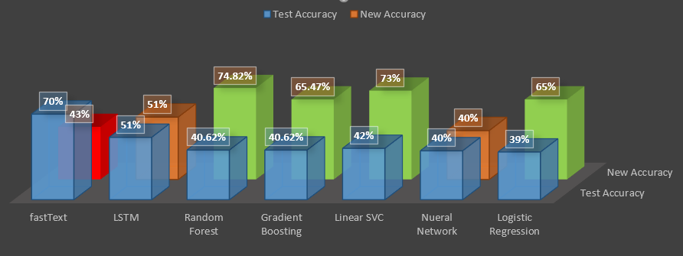
Tuned Models
The challenge at hand is that we do not have a large dataset, Our dataset has only 425 records
One of the main reasons for not achieving very high accuracy could be the lack of large labelled text datasets. Most of the labelled
text datasets are not big enough to train deep neural networks because these networks have a huge number of parameters
training such networks on small datasets will cause overfitting.
However we did implement SMOT(synthetic minority oversampling technique) and below were the results.
While it did improve the Accuracy, all Machine Learning models suffered overfitting we have used in the global dataset due to the lack of data size.
We are also aware that the NLP models are typically shallower and thus require different ﬁne-tuning methods
We have also examined BERT but couldn't make much headway as we have encountered issues such as packages incompatibility.
Version conflicts and few methods of the source files still not stabilized and in view of the above and in the interest of time we have parked BERT for future research.

Slide 27
Future footsteps to make it market scalable

Slide 28
Deployment Strategy
Setting up local RASA Workspace:
RASA has very good docs to help you set the framework. The process is well explained in the below link.
https://rasa.com/docs/rasa/installation/
Once installed RASA X can be launch to setup you first level of intents.
RASA X can be installed in local mode, server mode, by docker compose or by helm chart.
The guide is there in the below link:
https://rasa.com/docs/rasa-x/installation-and-setup/installation-guide
RASA has got its own UI once setup is done to be able to handle all the intent, setting an configuration at finger tips.
The manual is also there can be done with the help of RASA Docs.
Once done the RASA server can be started with command:
RASA RUN
The training needs to be done before and can be done with command
RASA TRAIN
Now this step needs to be done once all the model training is complete and the RASA action and Flash API is ready to be started
Setting up the client server (NGOK)
o NGROK can be found in the below link which can be downloaded and started.
https://ngrok.com/download
o The NGROK runs in CMD environment.
o Command:
NGROK HTTP 5005
Where 5005 is the port on which the RASA server will be running.
o NGROK has got its own debug window by which you can see the incoming requested received.
o These will help you to easily debug and find the root cause of the issue if you face a problem understanding the connection.

Slide 29
Deployment Strategy .. continued
Setting up Rasa Action server
o There is provision in RASA to use external hooks to receive information e.g., plugin external APIs or to perform special actions which is not possible via RASA NLU.
o We have use external model: FastText to reach our goal along with some intervention.
Setting up Flash API
Install FastText
This is required as step 5 loads a saved FastText model for prediction
Install Flash
This is required as step 5 opens a port on http://127.0.0.1:5000/ to listen on incoming requests using Flash
Set working directory in SafeBot_API_Pred_Multi.py or SafeBot_API_Pred_Multi.ipynb
Copy safebot_multi.bin to the working dirctory set in 3
Run SafeBot_API_Pred_Multi.py or SafeBot_API_Pred_Multi.ipynb
This enables Rasa to pass the accident description by calling http://127.0.0.1:5000/get_p_acc_lvl and this API performs the prediction and returns the Accident level and Potential Accident Level to Rasa through actions.py
Setting up SLACK
Slack can be setup using the instructions on the link below
https://rasa.com/docs/rasa/connectors/slack/
If you are using the default credentials that was used at demo time, then please make sure you are only updating the ‘Receiving Messages’ part in the link above, that is the web hook using NGROK.

Slide 30
Future footsteps to make it market scalable

Slide 31





Strategy Implementation and Management Process
The purpose of this slide is to provide a glimpse about the roll out plan of the product where a philosophical approach to business is discussed.
Develop alternative approaches.
Create service extension in the application to collect and feed to a RDS.
Host JAVA API in AWS for logical updates and service extensions.
Use AWS SDK for Python to feed the data to the Algorithm to Train and Test.
Performance and measurements.
Monitor health update and compare periodically.
Protect and leverage system to notify customer in need.
Create BI insights to better leverage in risk premium and create customer benefit strategies.
Approach industry with the chatbot .
Explain the benefits.
Adhere to GDPR norms by removing personnel information
Explain customer benefits.
Clarify
the vision
Gather and
Analyse Information
Formulate
A Strategy
Implement
The Strategy
Evaluate
And Control
Understand the need to the business.
Analysis to do .
Remove Stop words
Remove special characters.
Feed information to AI system.
Implement the strategy
Deploy the solution in cloud.
Make a process to maintain the ALOG and enhance in steps based on its maturity.
Make collaboration with wearable vendor for both ways benefits.

Slide 32
Future Insights

Slide 33





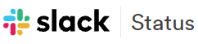


Integration Touchpoints
System of Engagement
Phone no. : 6366379913
Phone no. : 6366379913
Chat Systems
Email Systems
Do
Automation
Orchestration
System of Records
Phone no. : 6366379913
Phone no. : 6366379913
ITSM Integration
Think-learn
Anomaly Detection
Machine Learning
Policies
Outage prediction
INTEGRATION
System of Assurance
Phone no. : 6366379913
Monitoring Systems
Password Vault System
Phone no. : 6366379913
Interact
Collaboration
Notification
Chat Ops
Log Analysis
System that do
Phone no. : 6366379913
Automation
Systems

Slide 34
LIMITATIONS
CONSIDERATIONS
The Final end-to end model based on FastText architecture gave an aggregated accuracy of 64.00%, and may be suitable for deployment.
For the design NLP based potential accident level prediction, exploration of classical machine learning models (SVM, Light GBM, LSTM and others), may be used to develop the model that would be effective for problems of both regression and classification.
Data Quality is a problem and further exploratory data analysis, and feature extraction was required.
One big relationship the word2vec model does not allow us to capture is implicit negative signals. These can be especially relevant for modeling a user’s journey. We have created a separate RASA NLU to perform this activity.

Slide 35
References

Slide 36

Sl no. | Topic | Link
1 | RASA Installation | https://rasa.com/docs/rasa-x/installation-and-setup/installation-guide/
2 | RASA Slack INtegration | https://rasa.com/docs/rasa/connectors/slack/
3 | HEROKU deplyment | https://blog.heroku.com/how-to-deploy-your-slack-bots-to-heroku
4 | Local client server setup | https://ngrok.com/docs
5 |  | https://fasttext.cc/docs/en/support.html
6 | Creating WEB API | https://programminghistorian.org/en/lessons/creating-apis-with-python-and-flask
 |  | https://towardsdatascience.com/creating-restful-apis-using-flask-and-python-655bad51b24
7 | Training RASA NLU | https://rasa.com/docs/rasa/tuning-your-model/
8 | Analytics inference | https://www.kaggle.com/ihmstefanini/industrial-safety-and-health-analytics-database
9 | Business inference for situational analysis | http://eolss.net/Sample-Chapters/C16/E1-58-07.pdf
 |  | https://en.wikipedia.org/wiki/Industry_in_Brazil
10 | BI Solutions Study | https://rasa.com/blog/building-bots-with-rasa-shiba-slack-hosted-interface-for-business-analytics/

Slide 37
SEE
YOU

